Slide 1
Taking LARC Quality Improvement to Scale
Barbara Chase McKinney, MD, MPH
Twitter: @BCMcKinneyMD
16 July 2019 ~ Panafric Hotel ~ Nairobi, Kenya

Slide 2
Outcome: Kenya will scale-up the LARC Quality Improvement Methodology Applied to the HIV Viral Load Cascade and other health priorities
Notes:
Meeting Theme: The quality improvement methodology utilized in the LARC implementation has broad application to all health related challenges and will ultimately benefit the society at large.
Meeting Goals:
· Celebrate the LARC leadership and teams for their successful improvement within these health facilities.
· Chart the way forward - Taking LARC to scale will require leveraging the methodology and lessons learned, planning strategically, and engaging commitment and leadership.

Slide 3
Three Stories

Slide 4
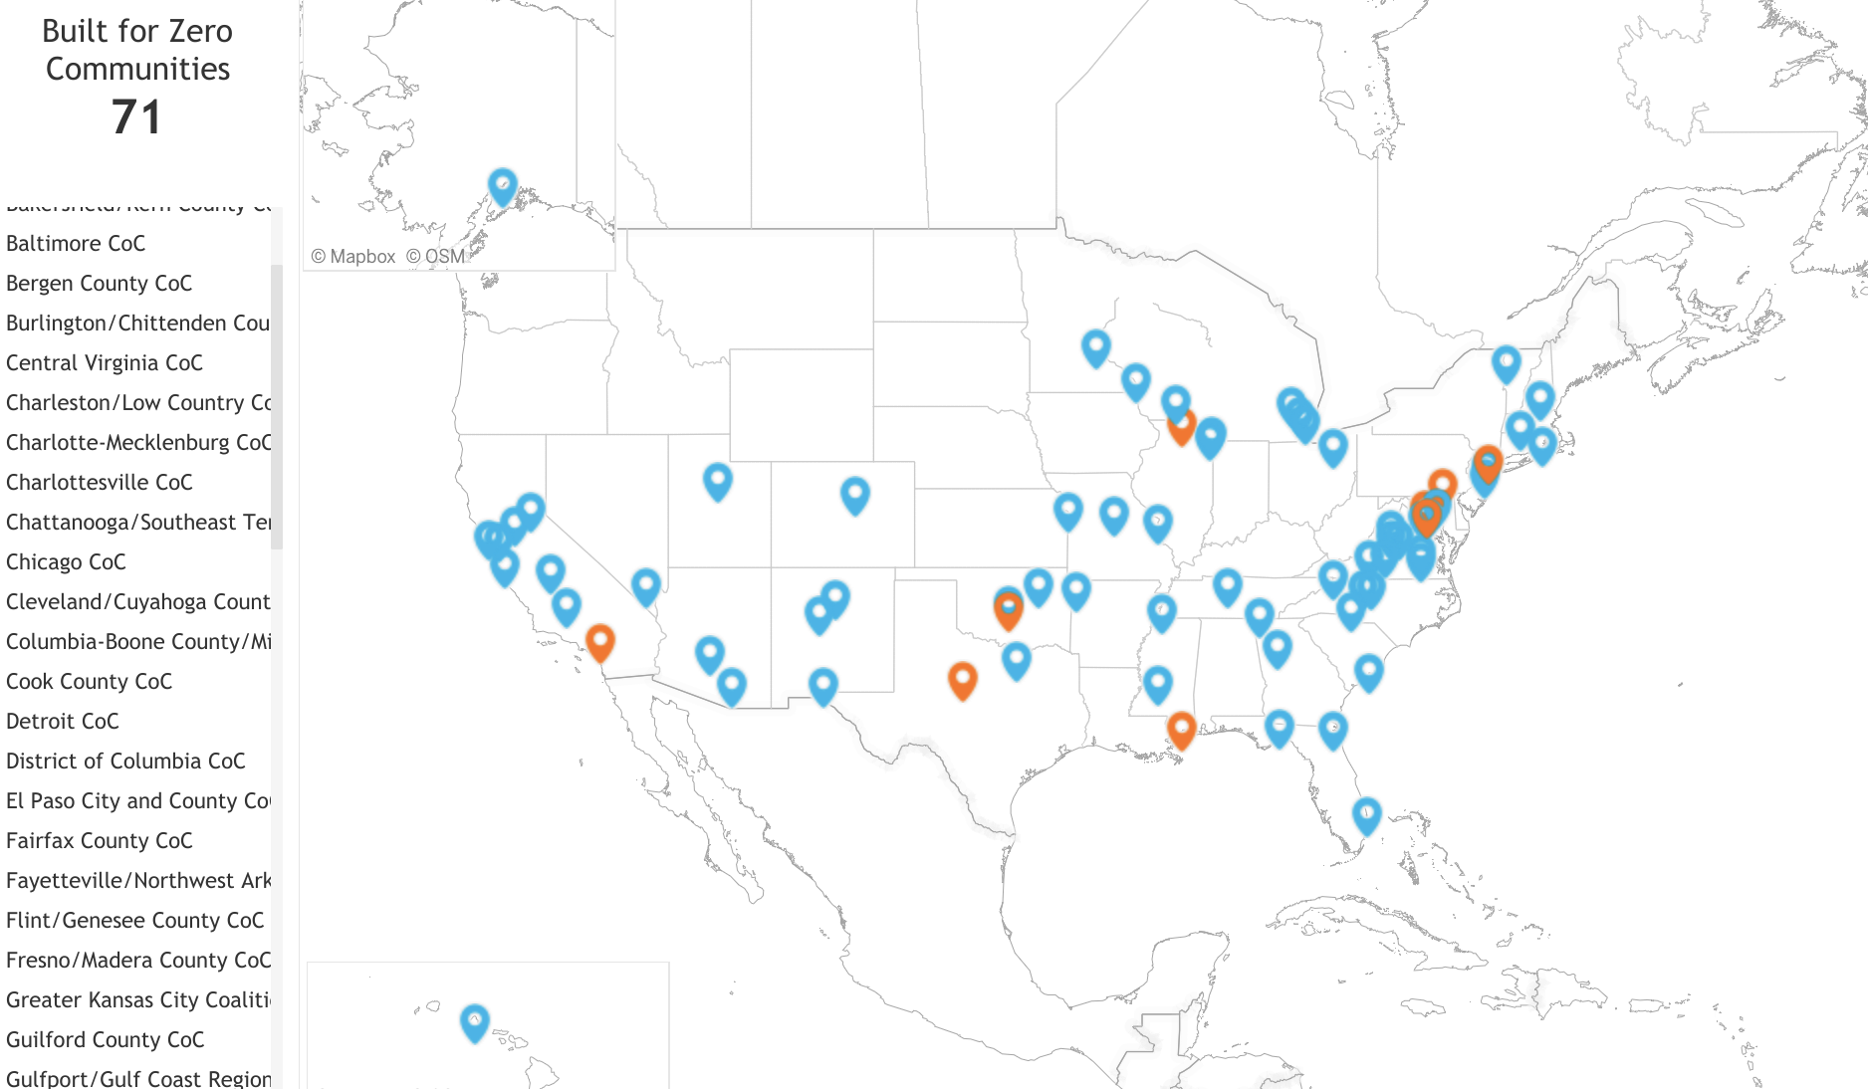
Chronic Homelessness in several US Cities drops to ZERO

Slide 5
Missed EAC Appointments Drop to ZERO
High Viral Load Results Documentation Increases to 100%
Drop
to ZERO
Increases
to 100%

Slide 6
31%
Reduction
Under-5 Mortality Rates Drop by 31-37%
37%
Reduction
35%
Reduction

Slide 7
Homelessness in the US

Slide 8
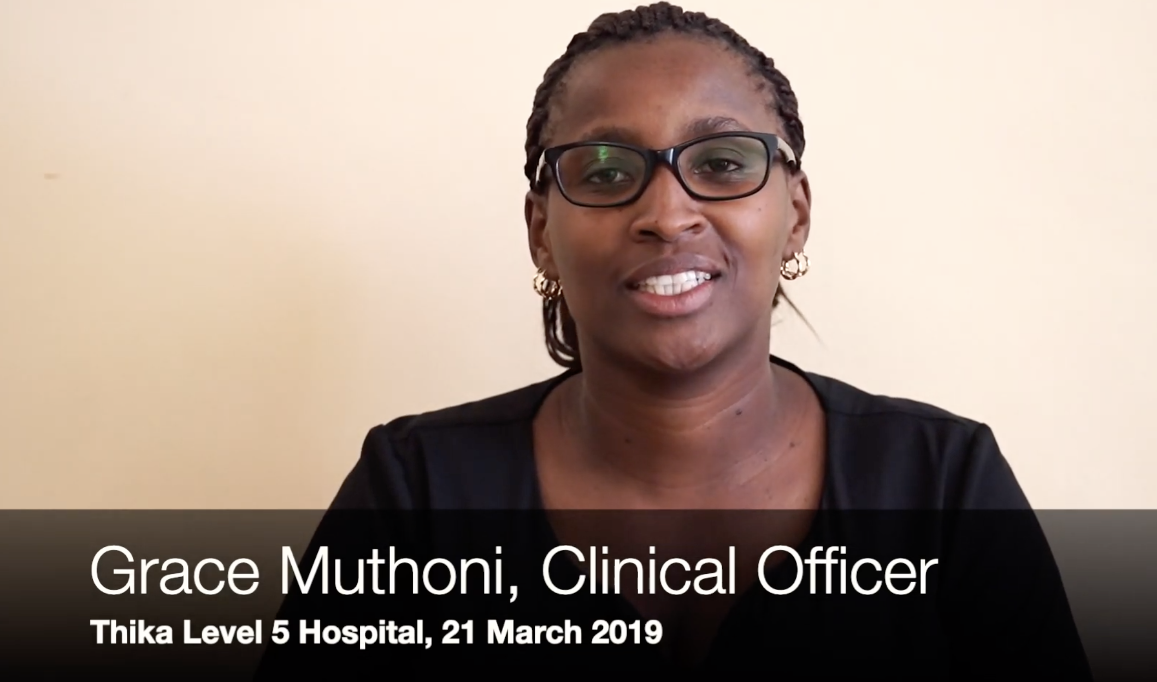
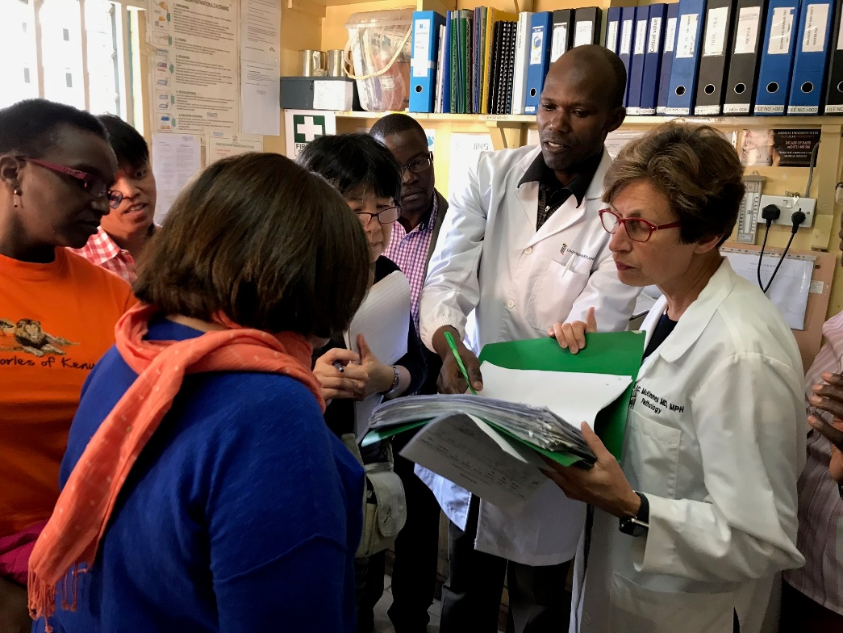
LARC Kenya
LARCCQI.org

Slide 9
Project Fives Alive!
Lessons Learned from Ghana’s Project Fives Alive!:
A practical guide for designing and executing large-scale improvement initiatives
http://www.ihi.org/resources/Pages/Publications/ProjectFivesAliveLessonsLearnedGuide.aspx

Slide 10
3 Headlines - 3 Very Different Stories
Homelessness
HIV Viral Load Scale-up
Under-5 Mortality

Slide 11
3 Very Different Stories –
ONE SOLUTION
Homelessness
HIV Viral Load Scale-up
Under-5 Mortality
Notes:
Would you be surprised if I told you that the organizations used one solution to achieve all these amazing results?

Slide 12
What is the secret sauce for Improvement? For Scale-Up?

Slide 13
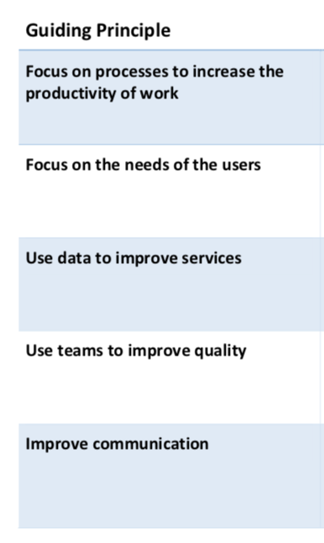
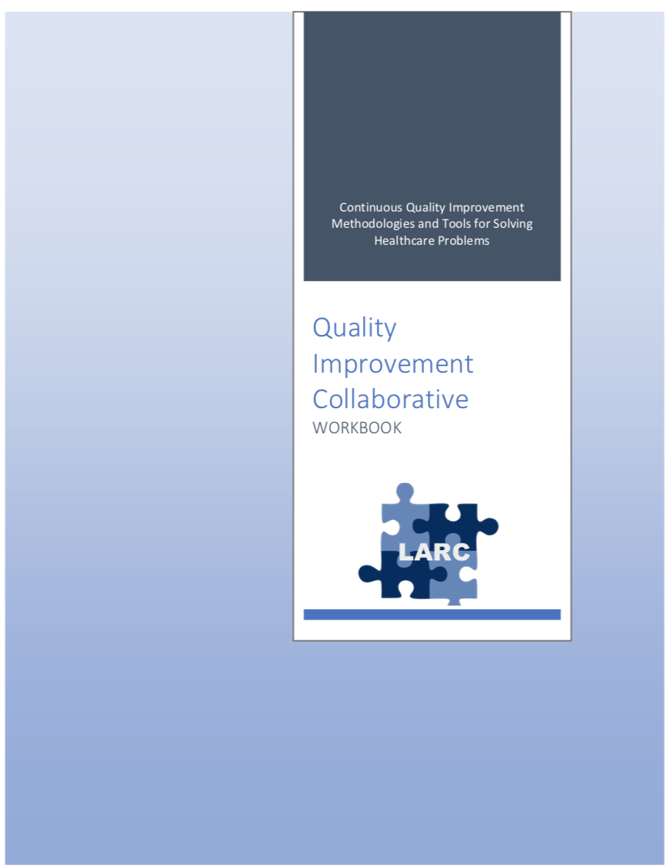
Notes:
Focus on processes to increase the productivity of work
New way of working
Understanding work as a collection of processes
Leaders making the new way of working attractive
Continuous Quality Improvement (CQI)
Each person has 2 Jobs – the job assigned AND to improve the job assigned
Role of leaders & managers in continual improvement
Faithfully employing QI methodology
Use data to improve services
Set ambitious aims/goals
Relentless focus on results
Use data to provide the feedback loop
Leadership engagement / accountability
Front-line engagement
QI methodology of testing change
Improve communication
Stakeholder engagement
Leadership Engagement
Alignment with healthcare system goals
To attain system level results

Slide 14
Process Mapping
Before: “I was thinking we were giving quality care.”
After: “I noticed there was a big gap.”

Slide 15
Notes:
Focus on processes to increase the productivity of work
New way of working
Understanding work as a collection of processes
Leaders making the new way of working attractive
Continuous Quality Improvement (CQI)
Each person has 2 Jobs – the job assigned AND to improve the job assigned
Role of leaders & managers in continual improvement
Faithfully employing QI methodology
Use data to improve services
Set ambitious aims/goals
Relentless focus on results
Use data to provide the feedback loop
Leadership engagement / accountability
Front-line engagement
QI methodology of testing change
Improve communication
Stakeholder engagement
Leadership Engagement
Alignment with healthcare system goals
To attain system level results

Slide 16
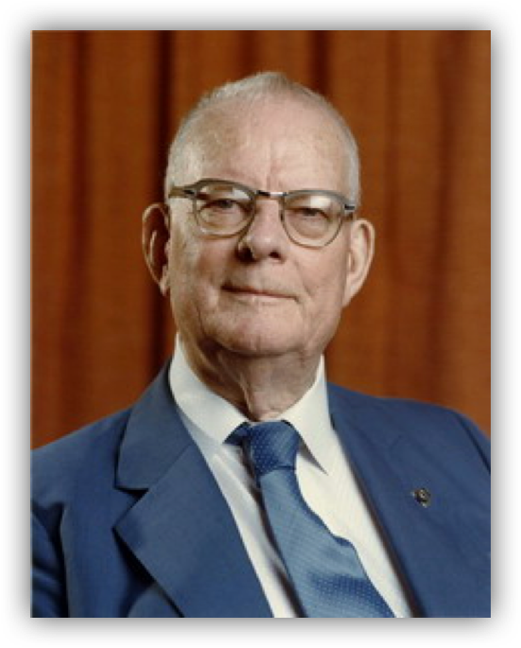
”In God we trust, all others must bring DATA.”
W Edwards Deming (1900-1993)

Slide 17
Getting to Zero - Homelessness
“…And have learned, 21st century skills, like using data for problem-solving, not for judgment, and quality improvement. ”
Notes:
552,830 people on a single night in 2018

Slide 18
Notes:
Focus on processes to increase the productivity of work
New way of working
Understanding work as a collection of processes
Leaders making the new way of working attractive
Continuous Quality Improvement (CQI)
Each person has 2 Jobs – the job assigned AND to improve the job assigned
Role of leaders & managers in continual improvement
Faithfully employing QI methodology
Use data to improve services
Set ambitious aims/goals
Relentless focus on results
Use data to provide the feedback loop
Leadership engagement / accountability
Front-line engagement
QI methodology of testing change
Improve communication
Stakeholder engagement
Leadership Engagement
Alignment with healthcare system goals
To attain system level results

Slide 19
Teams
Multidisciplinary
Laboratory-Clinical
Interface

Slide 20
Notes:
Focus on processes to increase the productivity of work
New way of working
Understanding work as a collection of processes
Leaders making the new way of working attractive
Continuous Quality Improvement (CQI)
Each person has 2 Jobs – the job assigned AND to improve the job assigned
Role of leaders & managers in continual improvement
Faithfully employing QI methodology
Use data to improve services
Set ambitious aims/goals
Relentless focus on results
Use data to provide the feedback loop
Leadership engagement / accountability
Front-line engagement
QI methodology of testing change
Improve communication
Stakeholder engagement
Leadership Engagement
Alignment with healthcare system goals
To attain system level results

Slide 21
31+ Quality Improvement Tools

Slide 22
Aim
Metric
Change
Notes:
DEFINE
MEASURE – without measurement – No improvement
ANALYZE – Homelessness
Model for Improvement - Big Ambitious Aim – Getting to ZERO – Getting to 100% in Documentation, Reducing Mortality

Slide 23
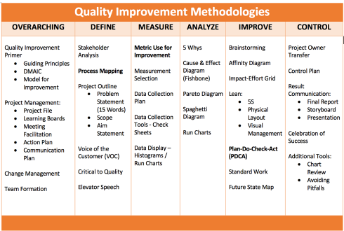
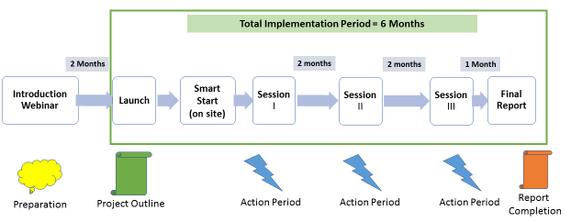
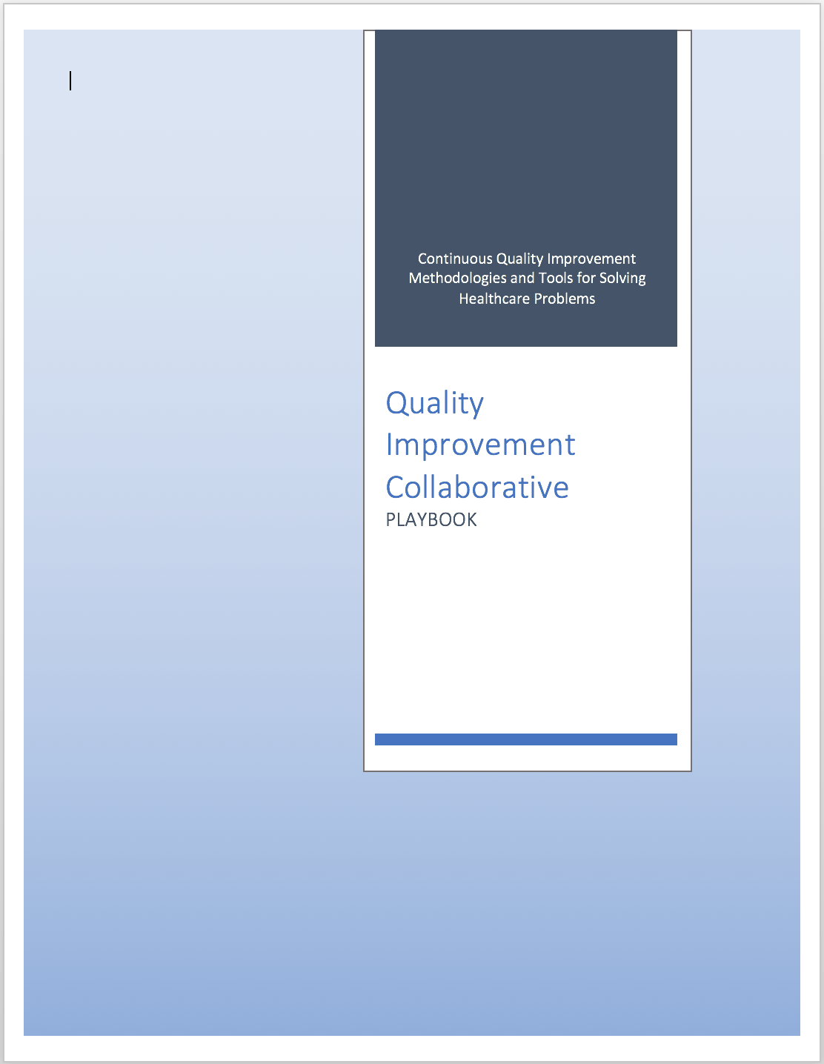
Curriculum + Delivery Model = Outcome
Curriculum
Program Delivery Model
QI Concepts/Skills
WORKBOOK
(QI TOOLS)
Notes:
LARC – 2 components
The educational content, - material, tools, concepts, skills = the curriculum – includes the content – delivered by PPT, and the Playbook – the resource for tools
The model of delivery - # of sessions, timing of sessions, action periods – all = The Delivery Model

Slide 24
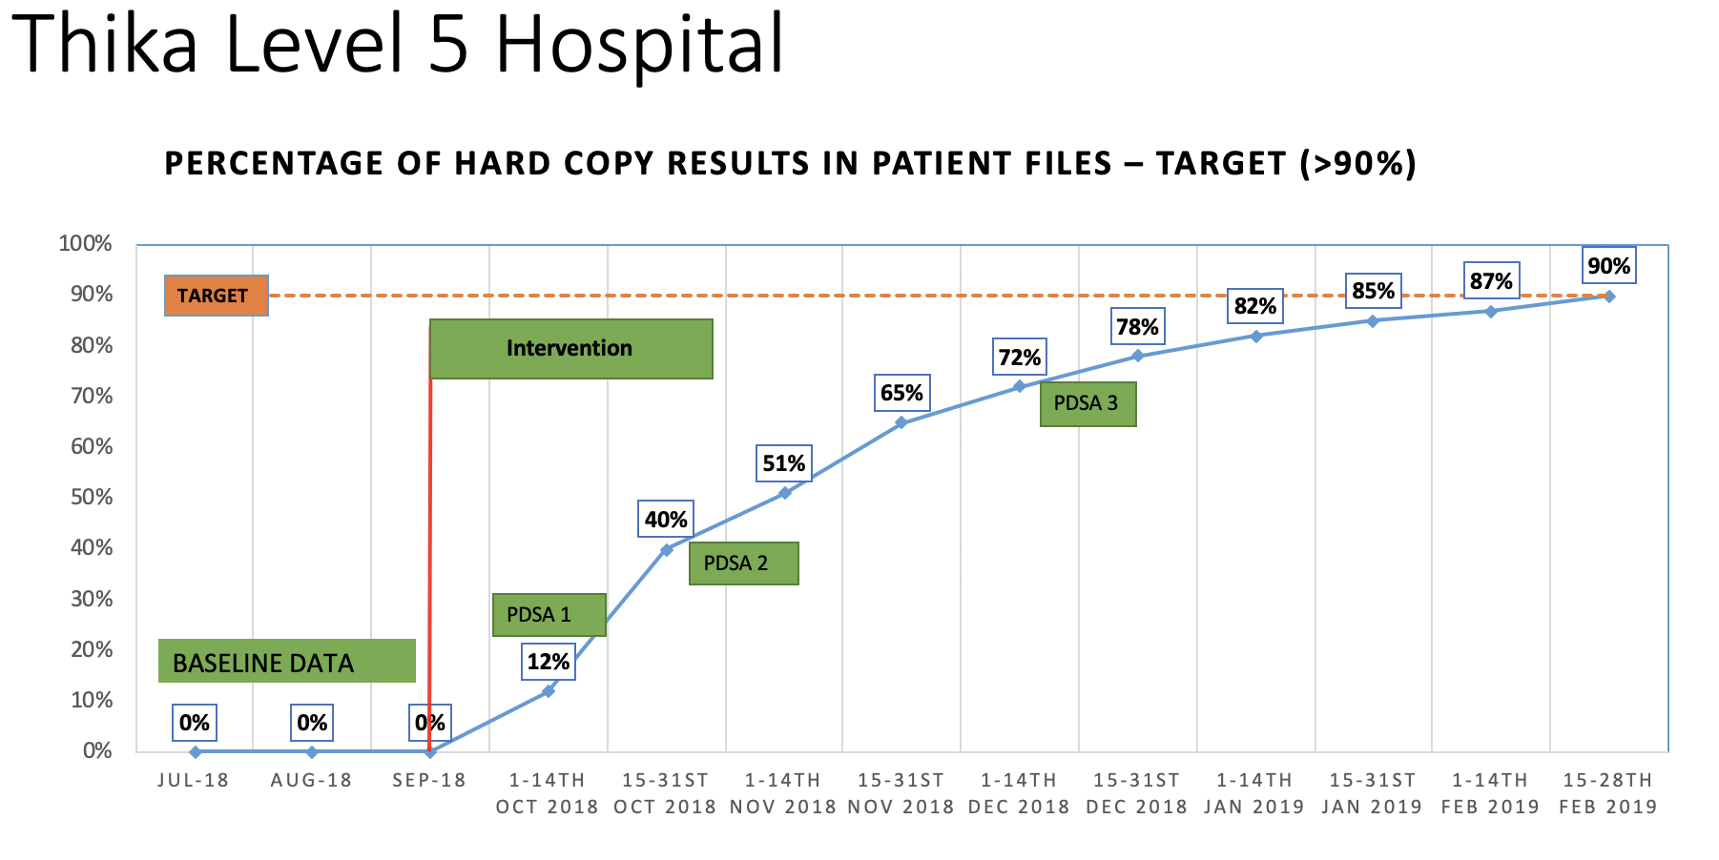
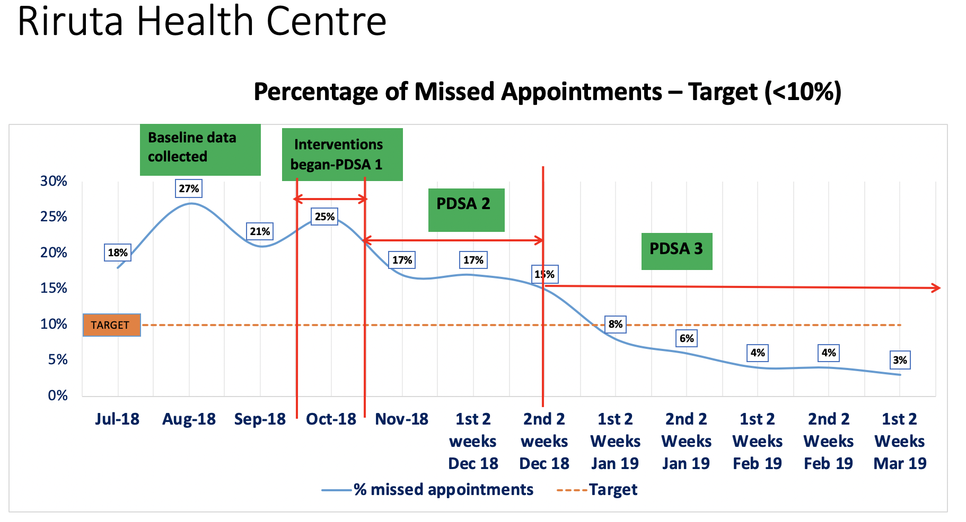
Direct Assistance Sites (5)
Notes:
Relentless Focus on Outcomes

Slide 25
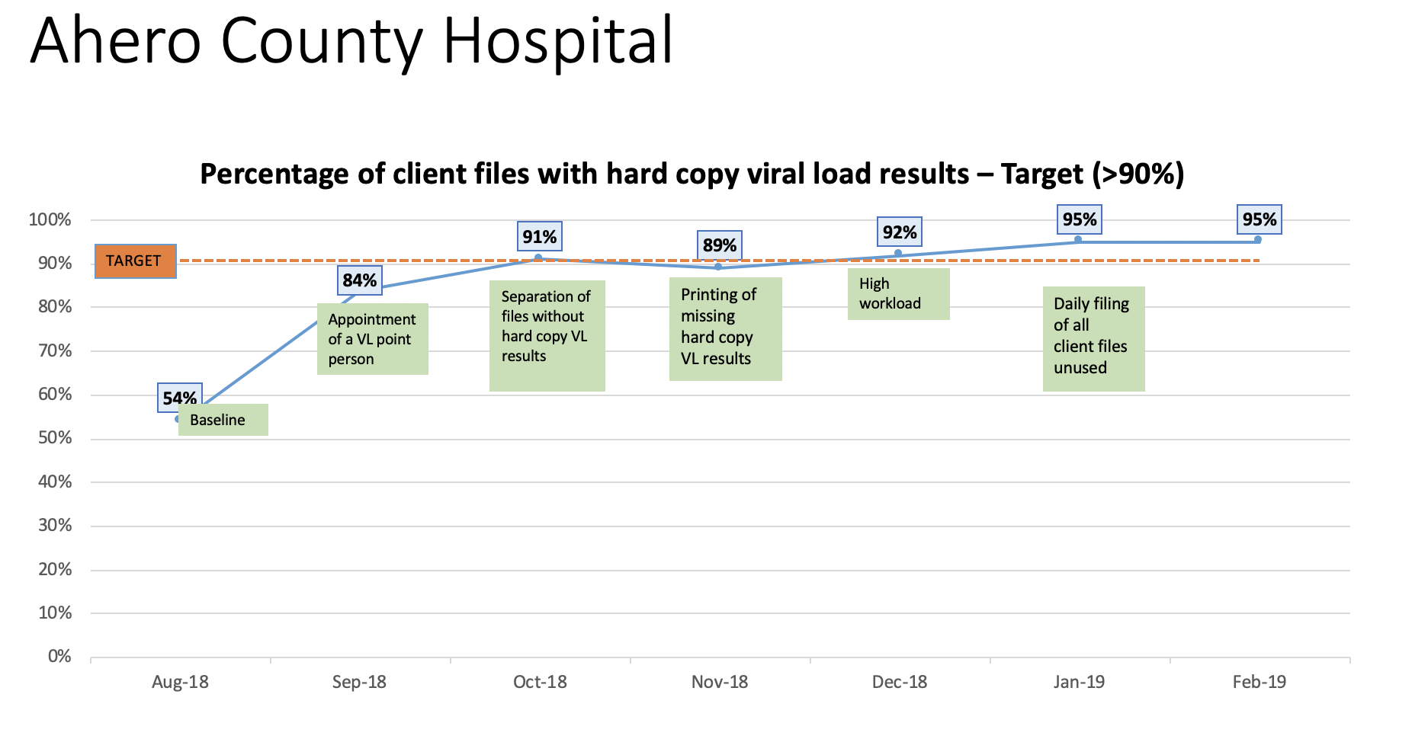
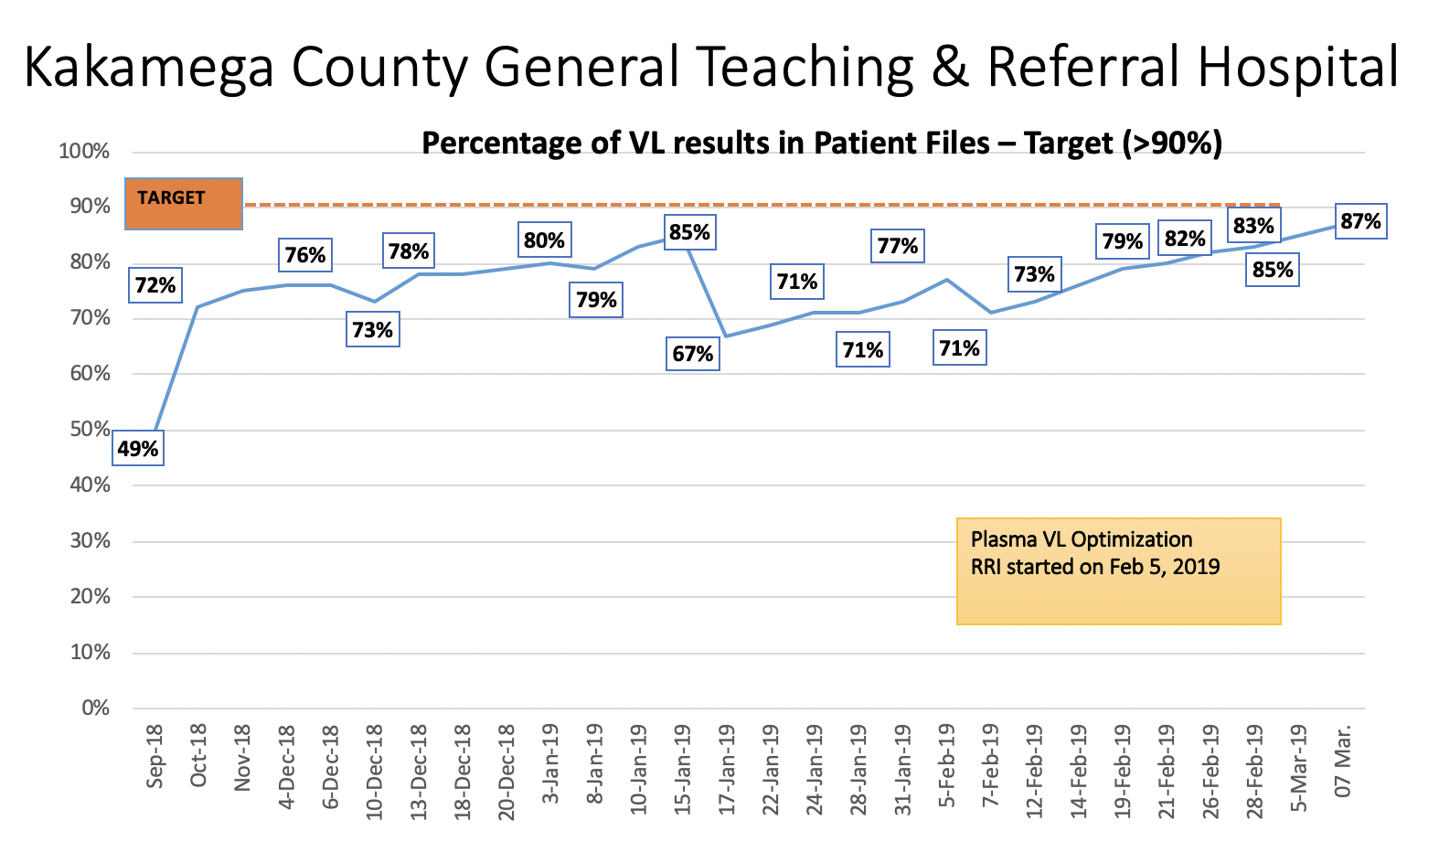
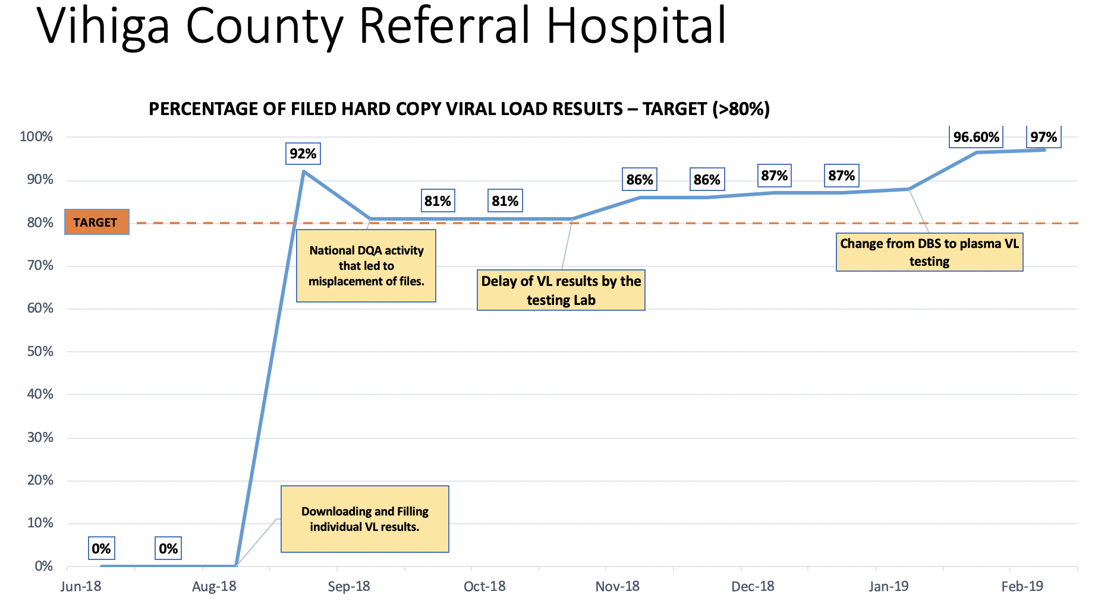
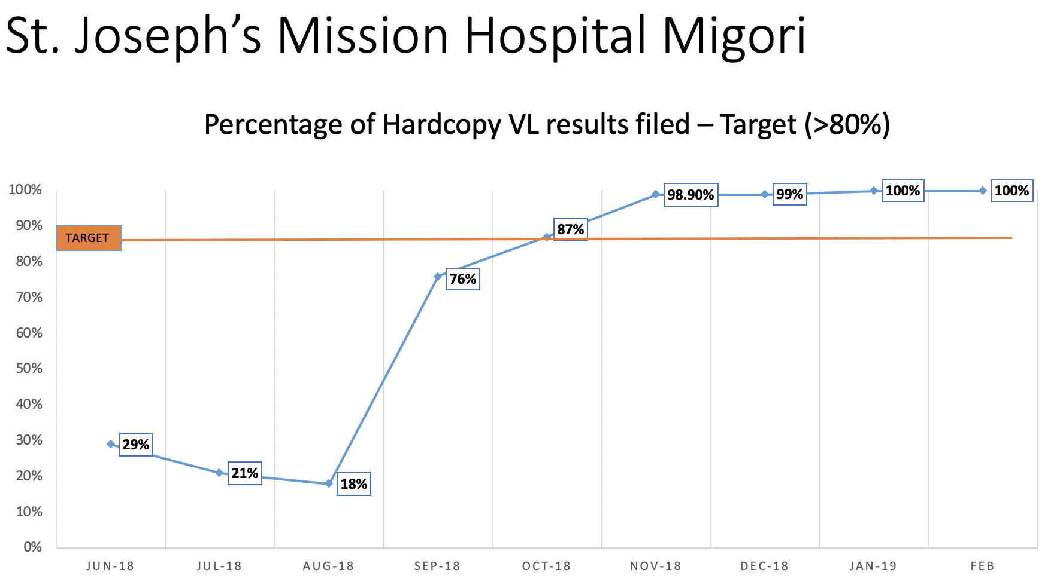
Remote Assistance Sites (6)

Slide 26
Project Fives Alive!
Lessons Learned from Ghana’s Project Fives Alive!:
A practical guide for designing and executing large-scale improvement initiatives
http://www.ihi.org/resources/Pages/Publications/ProjectFivesAliveLessonsLearnedGuide.aspx

Slide 27
Lessons Learned
QI Approach Actually Makes a Difference
Leaders & Managers create a platform for change
Front-line workers are empowered to develop, test, and implement their own innovative local solutions using local data to assess the effect of these changes

Slide 28
Project Fives Alive! Lessons Learned Publication

Slide 29
The Report
Project Design
Relationships
Leadership
Human Resources
QI Capacity
Measurement
Communication
What did PFA! get right?
What were the major challenges?
What useful lessons does PFA! hold for
other large-scale initiatives?
Key Success Factors
Key Challenges
Recommendations

Slide 30
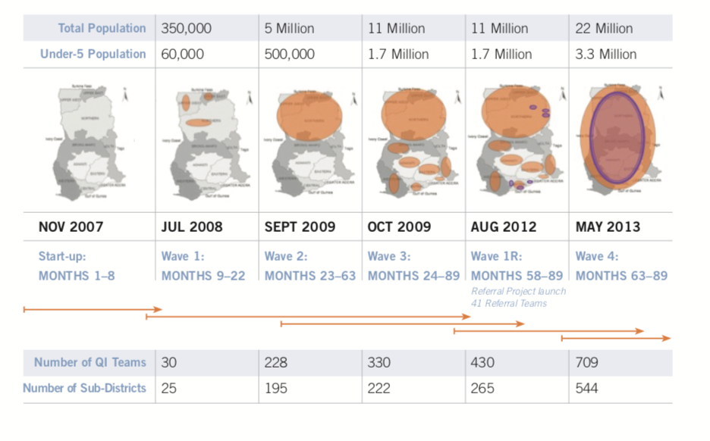
Project Design: Key Success Factors
Project Design
Learning System – harvesting what works & what does not work
From strong relationships with key stakeholders
Scale up the project in a series of “Waves”

Slide 31
Use QI in a disciplined way to drive results
What people said about PFA!
Resist, Resist, Resist…
“Too Intense”
Implement the full suite of QI methods
We just want people to be able to take a little bit of QI & run with it.”
Notes:
Bottle of Coke Light

Slide 32
QI Capacity
Project Design
Relationships
Leadership
Human Resources
QI Capacity
Measurement
Communication
Key Success Factors
Ambitious aims
QI teams
Collaborative model → accelerating peer-to-peer learning
Learning Sessions
Site Visits during Action Periods
PDSA on site
ID & Scale-up changes
Train partner organizations in QI
Notes:
An important component of sustainability is to also invest in training people in partner organizations in the QI methodology. This has proven key to PFA! ’s successes.

Slide 33
Measurement
Project Design
Relationships
Leadership
Human Resources
QI Capacity
Measurement
Communication
Key Success Factors
Create a culture driven by data & measurement for improvement
Work to improve data quality

Slide 34
Communication
Project Design
Relationships
Leadership
Human Resources
QI Capacity
Measurement
Communication
Key Success Factors
Strategic Communications Plan
Establish a system to harvest & disseminate learning
Make it a priority to tell your story

Slide 35
Leadership
Project Design
Relationships
Leadership
Human Resources
QI Capacity
Measurement
Communication
Key Success Factors
Leaders set the pace
Leaders promote enthusiasm, celebrate successes, & build teams
Leaders maintain a relentless focus on results & data
Key leaders need expertise in QI methodology
Empower people on the team
Notes:
To effectively guide this work, leaders need expertise in Quality Improvement (QI) methodology and its specific methods and tools, in addition to broader leadership skills.

Slide 36
Where are we now?

Slide 37
Celebrate LARC Successes
Notes:
Knoll

Slide 38
Celebrate Success

Slide 39
What it the way forward?

Slide 40
Next Step – Scaling-Up LARC

Slide 41
Outcome: Kenya will scale-up the LARC Quality Improvement Methodology Applied to the HIV Viral Load Cascade and other health priorities
Notes:
Meeting Theme: The quality improvement methodology utilized in the LARC implementation has broad application to all health related challenges and will ultimately benefit the society at large.
Meeting Goals:
· Celebrate the LARC leadership and teams for their successful improvement within these health facilities.
· Chart the way forward - Taking LARC to scale will require leveraging the methodology and lessons learned, planning strategically, and engaging commitment and leadership.

Slide 42
Summary
Leveraging the LARC Experience toward Scale-Up

Slide 43
What is the secret sauce for Improvement? For Scale-Up?

Slide 44
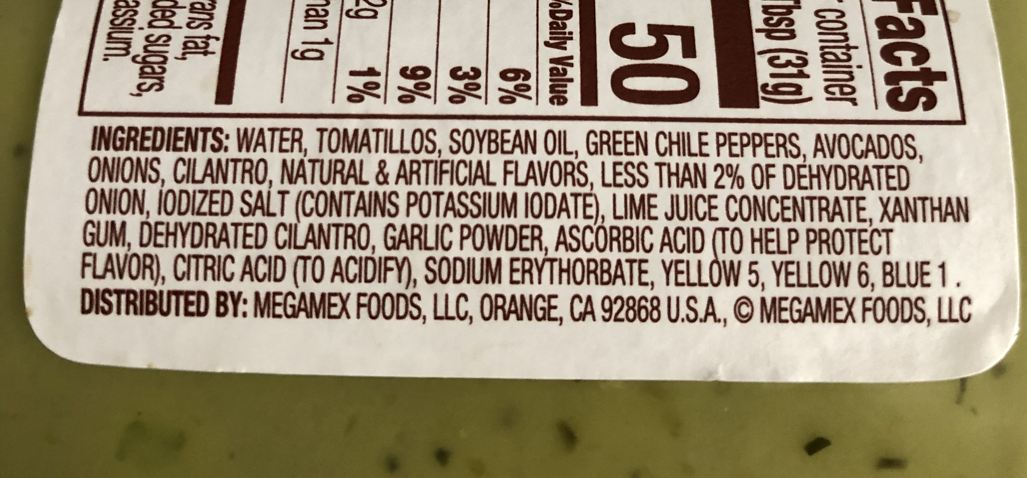
Notes:
My secret sauce has multiple ingredients.

Slide 45
Key ingredients
Leadership
Empowered CQI Teams
Learning Platform – Learning Collaborative
Relentless Focus on Results
Using Data
Quality Improvement Methodology
Strategic Hard Work
Believe it is #Solvable

Slide 46
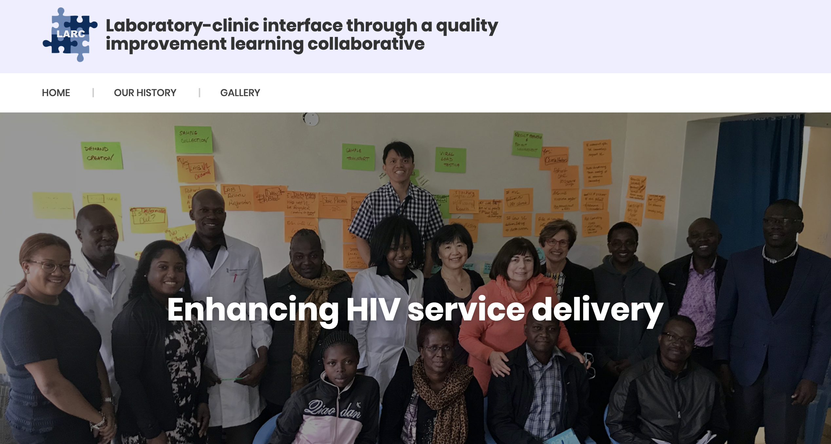
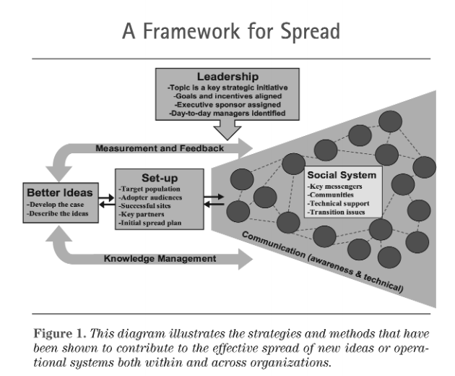
Resources
LARCCQI.org

Slide 47
What headaches, challenges, “pebble in your shoe” do you have?

Slide 48
Outcome: Kenya will scale-up the LARC Quality Improvement Methodology Applied to the HIV Viral Load Cascade and other health priorities
Notes:
Meeting Theme: The quality improvement methodology utilized in the LARC implementation has broad application to all health related challenges and will ultimately benefit the society at large.
Meeting Goals:
· Celebrate the LARC leadership and teams for their successful improvement within these health facilities.
· Chart the way forward - Taking LARC to scale will require leveraging the methodology and lessons learned, planning strategically, and engaging commitment and leadership.

Slide 49
Asante Sana Thank You

